Slide 1
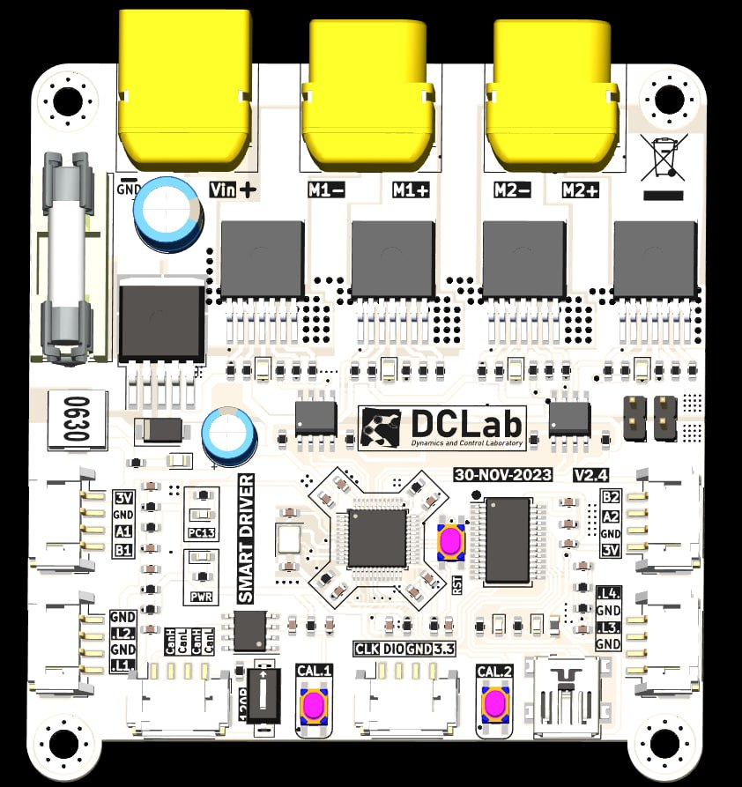
Complete Guide To Smart Driver

Slide 2
Content
Introduction
Connection
First Time Setup
Serial configuration
Estimation of the motor PPR
Can Bus message structure
Reset and Factory Reset
Saving Current Motor Parameters
Limitations
Using with Arduino IDE
Using with Simulink
Using with ROS2
Using Multiple Smart Drivers
Control using Serial

Slide 3
1.Introduction
This driver is capable of operating 2 DC Motors simultaneously.
There are 3 modes of operation:
Adaptive control
Manual PID control
Voltage control
By default, the driver use Adaptive control. It can be set later in the guide.
There are two ways to control the motor:
Via CAN Bus (Full support, included encoder feedback)
Via Serial Port (Only motor control supported)
The unit use in the drivers are:
Radians for position control
Radians/s for velocity control

Slide 4
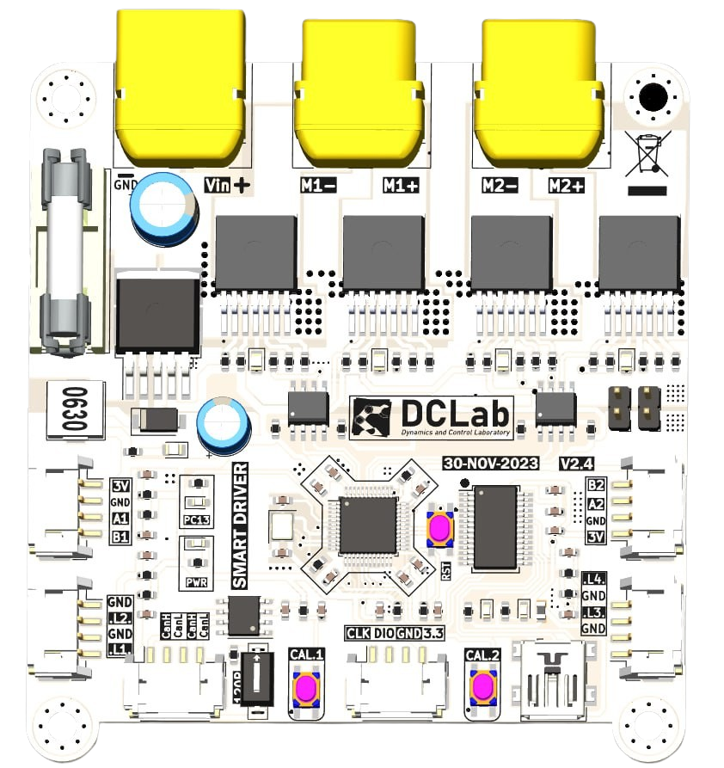
2.Connection
Note: M1 = Motor 1
M2 = Motor 2
M1 Input
7V to 27V input
M2 Input
M1 Encoder
M2 Encoder
120 Ohms switch
M1 Calibrate button
Reset Button
Serial port
M2 Calibrate button

Slide 5
3. First Time Set Up
The step to set up are:
Make sure that every connection is correct like in the previous slide
Config your actual PPR using Serial communication. If you do not know the PPR, Point 5 will help you.
Click on the calibration button for both the motor 1 and motor 2. The motors will start oscillating to calibrate the parameters. Wait for 5 seconds and then click both button to end the calibration. If you cannot afford to calibrate, there is an optional method to do this in Point 8.
If you are changing the motor to a new type, it is recommended to reset the motor parameters. You can go to Point 7.

Slide 6
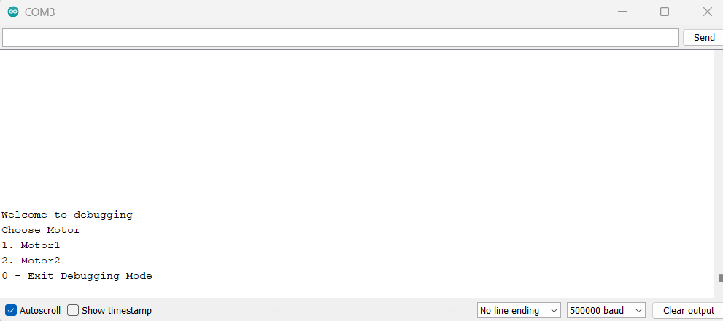
4.Serial interface
Plug the USB (Mini-B) to the computer.
Open Arduino IDE, Choose the appropriate COM port. Select the baudrate of 500000 with "No line ending".
Enter number "1":
You will be greeted with this message:

Slide 7
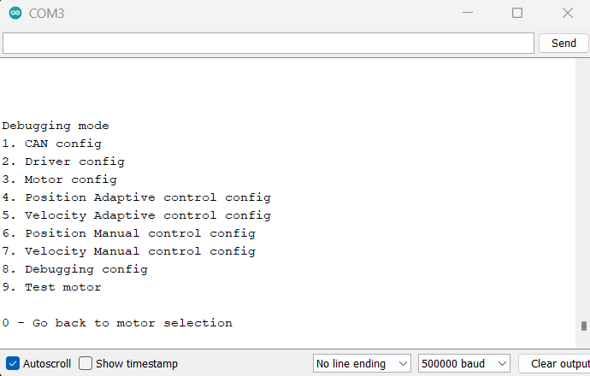
4.Serial interface (Cont)
Enter "1" or "2" To Config motor. You will be greeted by this message:
The next slide will explain what each config does.

Slide 8
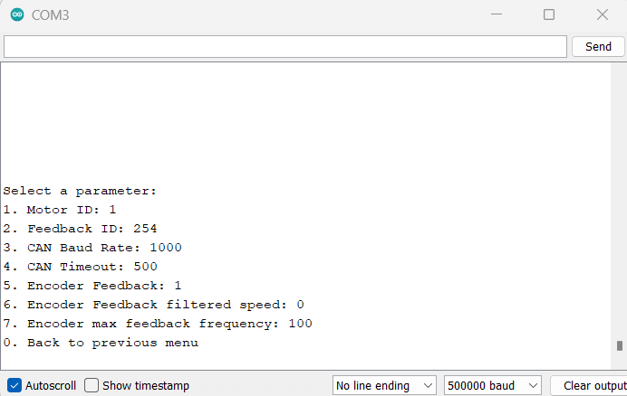
4.1. CAN Config
Motor ID: The CAN ID that the motor listen to (0 to 2047)
Feedback ID: The CAN ID that the motor use to feedback encoder data (0 to 2047)
CAN Baud Rate: Speed of CAN Bus in Kilobits (1000KBPS, 500KBPS, 200KBPS, 100KBPS)
CAN Timeout: Reset the Desired Speed to 0 if there is no CAN Message received (default 500ms)
Encoder Feedback: 1 To feedback encoder via CAN Bus, 0 to disable
Encoder Feedback filtered speed: 1 to Feedback Filtered Speed, 0 to Feedback calculated speed
Encoder max feedback frequency: Rate of which the encoder is feedback (Default 100Hz)

Slide 9
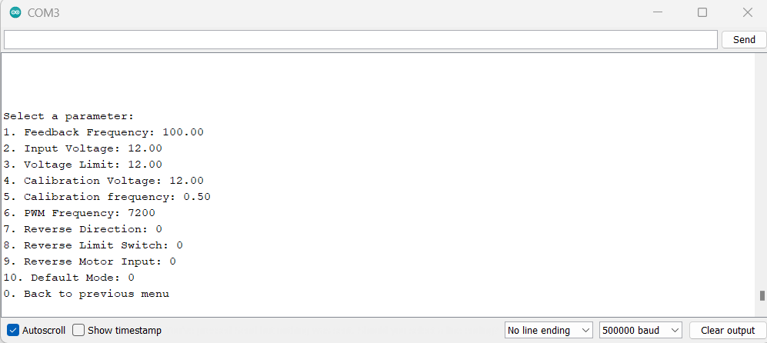
4.2. Driver Config
Feedback Frequency: The rate of the controller loop per second (Default: 100Hz)
Input Voltage: Your real input voltage (Will be used as a reference only) (7V to 27V)
Voltage Limit: Limit the output voltage (In reality, it limits the duty cycle) (7V to 27V)
Calibration voltage: The maximum voltage during calibration phase of the motor. (7V to 27V)
Calibration frequency: The frequency of which the motor use to calibrate. (Default 0.5Hz)
PWM Frequency: The PWM frequency at the output of the motor (Default 7200Hz)
Reverse Direction: Reverse the position count (either 0 or 1)
Reverse Limit Switch: Reverse the direction of limit switch (either 0 or 1)
Reverse Motor Input: Reverse the output of the motor (either 0 or 1)
Default Mode: At start up, the driver will use: 0 (Voltage Mode), 1 (Speed Mode), 2 (Position Mode)

Slide 10
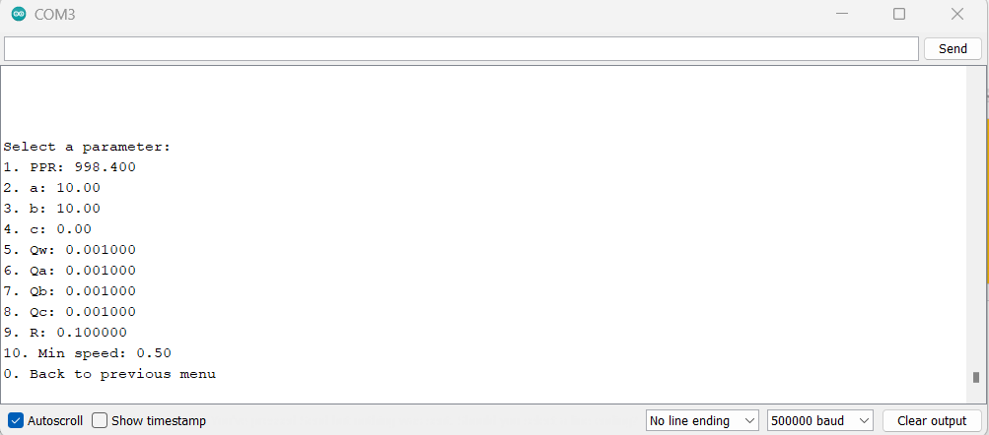
4.3. Driver Config
PPR: The number of pulses count from Encoder per revolution at the motor output
a: Coefficient of the speed (Determined during Calibration)
b: Coefficient of the voltage (Determined during Calibration)
c: Coefficient of the friction (Determined during Calibration)
Qw: Rate of speed estimation
Qa: Rate of "a" estimation
Qb: Rate of "b" estimation
Qc: Rate of "c" estimation
Note: For Q-tuning, choose large value to get fast parameter estimation but introduces more noise (default 0.001)
9. R: Trust factor of encoder (Large value if encoder is noisy but slower convergence rate, default 0.1)
10. Min speed: Minimum speed for real time parameters estimation (Default 0.5 rad/s)

Slide 11
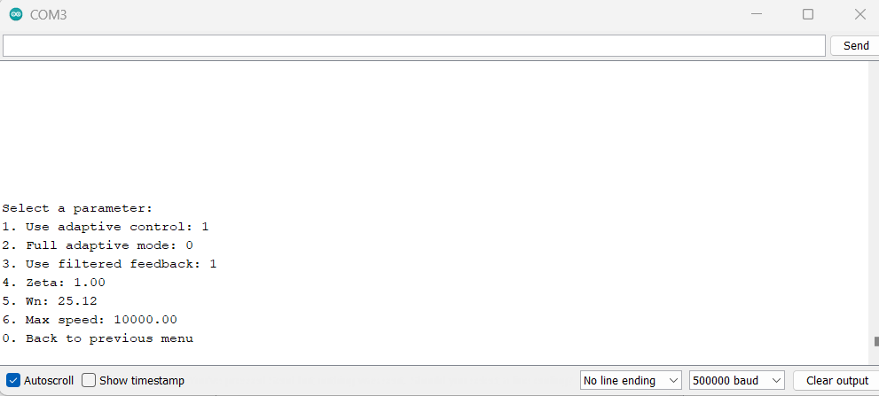
4.4. Position Adaptive Control Config
Use adaptive control: (1 = Adaptive control, 0 = Manual control)
Full adaptive mode: (1: Compensate the friction and desired goal rate, 0: No compensation)
Use filtered feedback: (1 = Use filtered speed to feedback, 0 = Use measured speed to feedback)
Zeta: Damping ratio (Default = 1)
Wn: Natural frequency (Default = 25.12)
Max speed: Speed limit for position control

Slide 12
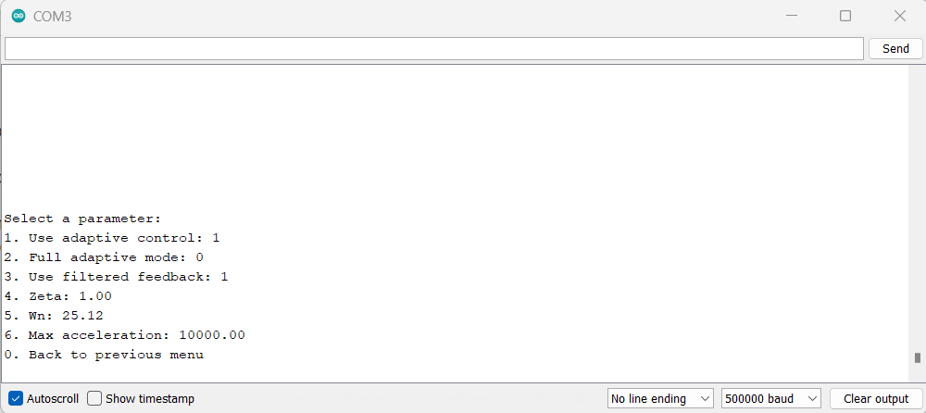
4.5. Velocity Adaptive Control Config
Use adaptive control: (1 = Adaptive control, 0 = Manual control)
Full adaptive mode: (1: Compensate the friction and desired goal rate, 0: No compensation)
Use filtered feedback: (1 = Use filtered speed to feedback, 0 = Use measured speed to feedback)
Zeta: Damping ratio (Default = 1)
Wn: Natural frequency (Default = 25.12)
Max acceleration: Acceleration limit for velocity control

Slide 13
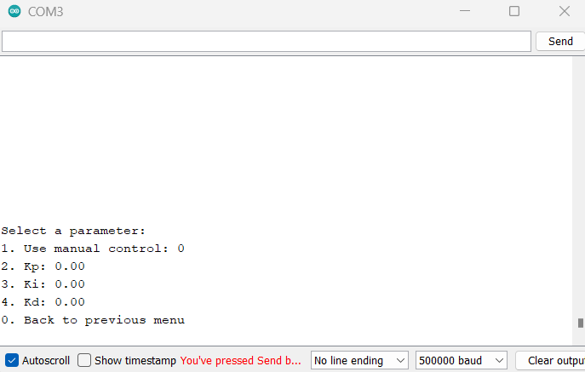
4.6. Position Manual Control Config
Use manual control: (0 = Adaptive control, 1 = Manual control)
Kp
Ki
Kd
Note: After you calibrate the motor, the Kp will be chosen for you and you can use this as a starting point for your own PID tuning.

Slide 14
4.7. Velocity Manual Control Config
Use manual control: (0 = Adaptive control, 1 = Manual control)
Kp
Ki
Kd
Note: After you calibrate the motor, the Ki will be chosen for you and you can use this as a starting point for your own PID tuning.

Slide 15
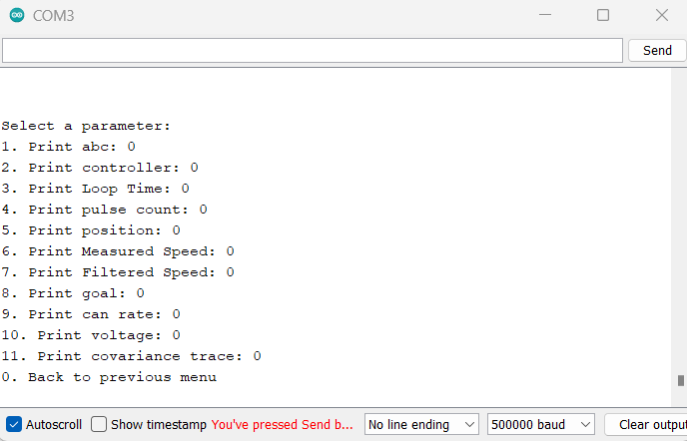
4.8. Debugging Config
Print abc: print the estimated parameters
Print controller: print the current controller
Print Loop Time: print the time it take to complete one feedback loop. Useful for determining the maximum feedback frequency. Under normal condition, it will take less than 700 us to complete one feedback loop for a motor. Thus in theory, we can use feedback loop up to 1000000 / 700 / 2 equals to around 700 Hz.
Print pulse count: print the pulses count since the start. Useful to determine the PPR of your Motor.
Print position: print the position in radians.
Print Measured Speed: print the calculated speed
Print Measured Speed: print the filtered speed
Print goal: print the desired goal
Print CAN rate: print the number of can messages receive per second
Print voltage: print the value of voltage output
Print covariance trace: print the trace of cavariance matrix (lower = better)

Slide 16
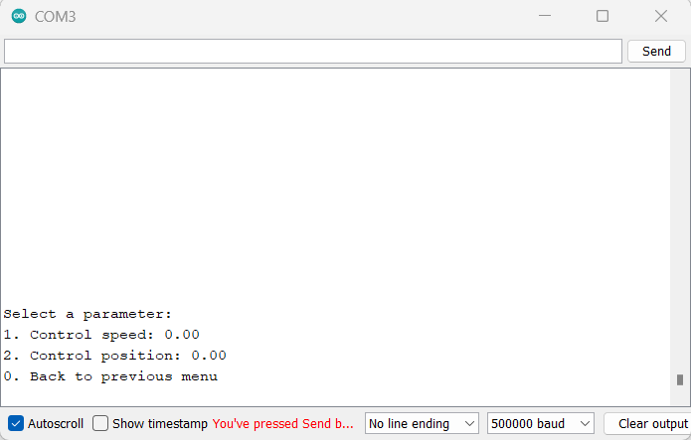
4.9. Test motor
This config provides easy solution to test whether the motor is working or not. The output is updated in real time.
Control speed: desired speed in radians/s
Control position: desired position in radians

Slide 17
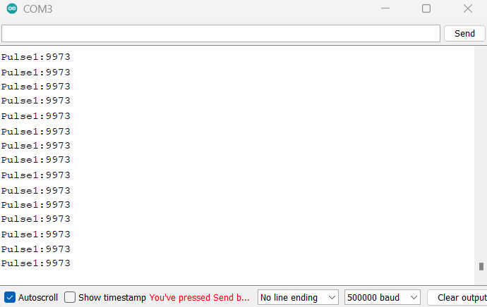
5. Estimation of motor PPR
There are 2 ways of estimating the motor PPR:
Via Calculation: PPR = 4 x Gear Box x Encoder PPR
Via Serial debugging:
+Enable the serial print of pulse count, make sure the value is 0 (you can do this by pressing the reset button)
+Rotate the output of the motor 10 times, and your PPR can be calculated using PPR = pulses count / 10.
In this case, the PPR of the motor is 997.3

Slide 18
6. CAN Bus Message structure
For this driver, we use normal 11 bits identifier standard message with data length of 8 bytes.
To control the motor, there are 6 parameters for CAN BUS.
SpeedMode: 0 for position control, 1 for velocity control (First bit of byte 0)
Stop: 0 for normal operation, 1 to stop the motor (Second bit of byte 0)
Reset: 0 for normal operation, 1 to reset the motor position to 0 (Third bit of byte 0)
VoltageMode: 0 for normal operation, 1 to enable voltage control mode (Forth bit of byte 0). VoltageMode = 1 will override SpeedMode
5. Goal: The value can be:
+Desired position if (speedMode = 0 and VoltageMode = 0)
+Desired velocity if (speedMode = 1 and VoltageMode = 0)
+Voltage if (VoltageMode = 1)
Goal is a float32 value occupying 4 bytes (From byte 2 to byte 6)
Here is what the code message structure look like in C and C++
Msg[0] = speedMode + (Stop << 1) + (Reset << 2) + (VoltageMode << 3);
Memcpy(&Msg[2], &Goal, sizeof(float));

Slide 19
6. CAN Bus Message structure (CONT)
This driver offer the ability to provide encoder feedback.
Below is the message structure:
Position (Float32 Occupying byte 0 to byte 3)
Speed (Float32 Occupying byte 4 to byte 7)
Below is the example of obtaining Position and Speed in C and C++:
float feedback_speed;
float feedback_position;
memcpy(&feedback_position, can_msg_receive.data, sizeof(float));
memcpy(&feedback_speed, can_msg_receive.data + 4, sizeof(float));

Slide 20
7. Reset and Factory Reset
If you want to restore the configuration back to default, you can do the following:
Plug in your driver to PC.
Hold the Motor 1 Calibration Button.
Click reset button while still holding the calibration button.
Wait until you see "Driver Reset" and then release the button.
There is an option to do the soft reset. You can follow the above step but on Motor 2 calibration button instead. You can do this when you wish to only reset the estimation parameters in case of divergent estimation.

Slide 21
8. Manually Saving current motor parameters
Motors are usually calibrated without load. It provides a starting point for future parameters estimation. The parameters without load and with load are quite different.
For example: For Mobile robot case, the Smart Driver will take sometimes to estimate the parameter to achieve stable result. Without manually saving the parameters, we will lose the current parameters the next time we use it. To solve this, you can move the mobile robot until it is stable, then you can manually save the motor parameters via serial by using "save1" to save parameters of motor 1 and "save2" to save parameters of motor 2.

Slide 22
9. Limitations
Adaptive Control Mode is only applicable for application where the gravity has no effect on the movement of motor. For example: Mobile Robot, SCARA.
For Robot arms, it is recommended to use Manual Control mode (Can be done through serial configuration).
If you would like to implement your own control architecture, you can obtain the encoder feedback and use voltage control mode.

Slide 23
10. Using With Arduino IDE
Download the Arduino Library here:
https://drive.google.com/file/d/1UgVAx1sYFo93mfAD60C367BbiyxWDyMU/view?usp=sharing
The library provides an example on how to communicate with smart driver using MCP2515 and Arduino IDE.
If you are using different CAN module, you can slightly modify the code and swap out the MCP2515 code.
If you are using STM32CubeIDE, you can import the the source file and header file into your project and learn the structure on how to interface it from the .ino file.
There are 3 separate examples on how to Control the Motor, Get Encoder Feedback from the driver and Both methods at the same time.
Note: If you are using MCP2515, please make sure you have the MCP2515 library installed on your system. You can do this using Library manager on Arduino IDE and search for MCP2515. Download the autowp version.

Slide 24
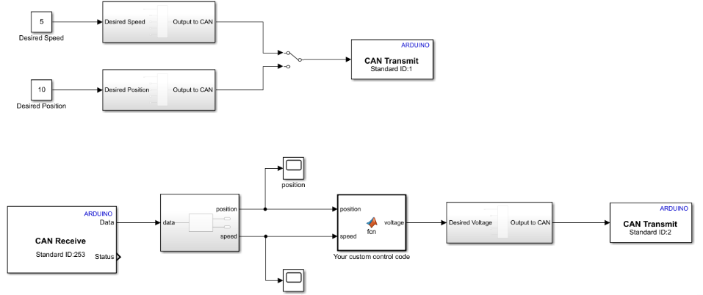
11. Using with Simulink
Download the Simulink model.
https://drive.google.com/file/d/1Uxt2IM74cLjwBSixmIsk1YLC0gu-0bgF/view?usp=sharing
The library assumes that you are using MCP2515. If you are using different Can Module, you can modify the Can Bus block with your own appropriate block.
You can control the motor and get the encoder feedback from the Simulink model.
Note: The CAN Baud Rate is 1Mbps.

Slide 25
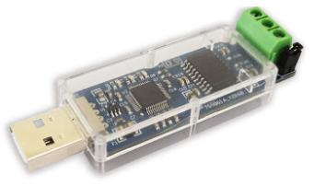
12. Using with ROS2
Download the package here. https://drive.google.com/file/d/1om3PL_NLT4tTa8czDJ7X0aM4HC4J-RLm/view?usp=sharing
Copy them to your ros2 workspace src and build them.
To run the node:
ros2 run can_motor motor_sender_node (For motor control)
ros2 run can_motor motor_receiver_node (For receiving encoder feedback)
Example on how to use with Python:
https://drive.google.com/file/d/1iS2THt6uvt2AFEtFfaY77nUeN1qyZAMK/view?usp=sharing
You need this CAN2USB for it to work! (CANABLE CAN2USB)

Slide 26
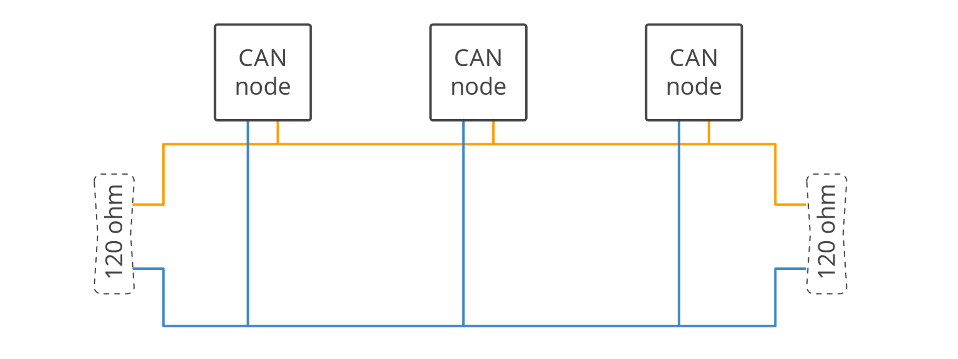
13. Using Multiple Smart Driver
The CAN Bus is connected together in series (Or Daisy-chain). There 120 ohms must be present at both end of the network.

Slide 27
14. Using With Arduino IDE
The driver was not designed to be control by Serial since the Serial communication is plagued with noises at high baud rate and frequency.
Thus, we add the ability to control the motor using Serial but at low frequency.
The sampling frequency to send the serial should be below 90 Hz. (45 Hz for each motor).
You can send the serial data following the structure:
"S1:speed" (Example: "S1:5.2" will send the velocity command to Motor 1 with desired velocity of 5.2 rad/s)
"S2:speed" (Example: "S2:5.2" will send the velocity command to Motor 2 with desired velocity of 5.2 rad/s)
"P1:position" (Example: "P1:5.2" will send the position command to Motor 1 with desired position of 5.2 rad/s)
"P2:position" (Example: "P2:5.2" will send the position command to Motor 2 with desired position of 5.2 rad/s)
Note: Negative number is also accepted. Example: S1:-5.2

